Slide 1


Smart india hackathon
MINISTRY OF
AGRICULTURE
& FARMERS WELFARE
SMART INDIA
HACKATHON
2024
Ps Code :sih1637
Team name : nextgen innovators
Problem statement title : mobile app for direct market access for farmers
Team leader name :Prashant Raj
Institute code(aishe) : U-0064
Institute name :Indian institute of technology ,patna
Theme Name : agriculture, foodtech &Rural development

Slide 2




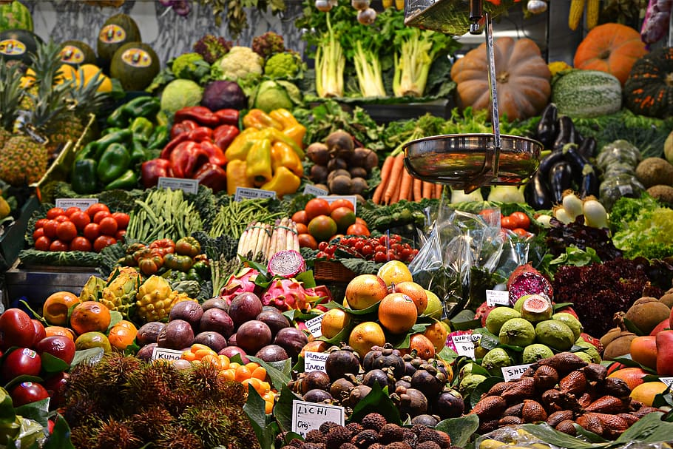
Idea/approach
Farmers
Negotiate their deals to sell at good rates
Buy their necessity from retailers at cheap rates
Restricting price by using MSP decided by Indian Government
Advanced modern techniques
Alert them about weather
Resolve query by experts
Modern Techniques
Weather reports
Good deals
App
Fresh vegetables
Delivery
Technology
More Access to Customers
App – react native
Backend-Node.js
Database-My SQL
Buyers
shopkeepers

Slide 3




Idea/ Approach
BUY
Sell
Business Models
Advertisement
Collabaration with retailers
Subscription for query
Weather Report
Discover
Describe your Dependencies / Show stopper here
भारत में खेती अब नई तकनीकी से
Experienced Experts to solve query of farmers.
Meterological department to provide current status of weather.
Telecommunication industry for better facilities of Internet.
This Photo by Unknown Author is licensed under CC BY-NC

Slide 4
Farmer
Sell their product directly to customer
Customer Get fresh fruits & Vegetables at lower rate from market
Sell
Fertiliser
At
Cheap
Rate
Information about weather earlier
My App
Advanced modern techniques
Retailer
Query solution by expert
More access to customer
Promote Bio-Compost
Restricting prices of crop by MSP
Rent machines & earn money
Information about insecticides & pesticides

Slide 5
Team mEmber details
Team Leader Name: Prashant Raj
CSE (Btech): semester(1) Year (I)
Team Member 1 Name: Rahul Kumar Sahoo
CSE (Btech): semester(1) Year (I)
Team Member 2 Name: Aditya Kumar Lal
CSE (Btech): semester(1) Year (I)
Team Member 3 Name: Shivam Prakash
CSE (Btech): semester(1) Year (I)
Team Member 4 Name: Jangiti Vennela
CSE (Btech): semester(1) Year (I)
Team Member 5 Name: Kanishka
CSE (Btech): semester(1) Year (I)
Special Thanks to Saubhagya Ji Jaiswal(ME, IITP , Semester 1)

